Slide 1

CSS
Lesson 4

Slide 2
CSS Links
Links can be styled with any CSS property (e.g. color, font-family, background, etc.).
Links four states
a:link - a normal, unvisited link
a:visited - a link the user has visited
a:hover - a link when the user mouses over it
a:active - a link the moment it is clicked

Slide 3
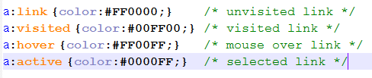
CSS Links
style.css
doc.html
<!DOCTYPE html>
<html>
<head>
<link rel= "stylesheet " type="text/css" href="style.css">
</head>
<body>
<a href="http://nverner.am" target="_blank">This is a link</a>
</body>
</html>

Slide 4

CSS Links
a:hover MUST come after a:link and a:visited
a:active MUST come after a:hover
style.css
doc.html
<!DOCTYPE html>
<html>
<head>
<link rel= "stylesheet " type="text/css" href="style.css">
</head>
<body>
<a href="http://nverner.am" target="_blank">This is a link</a>
</body>
</html>

Slide 5

CSS Links
style.css
doc.html
<!DOCTYPE html>
<html>
<head>
<link rel= "stylesheet " type="text/css" href="style.css">
</head>
<body>
<a href="http://nverner.am" target="_blank">This is a link</a>
</body>
</html>

Slide 6
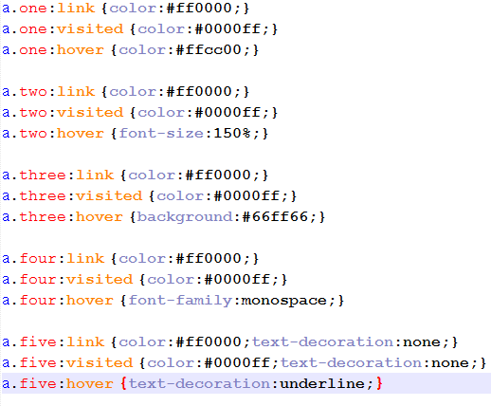
CSS Links
style.css
Add different styles to hyperlinks

Slide 7
CSS Links
doc.html
<!DOCTYPE html>
<html>
<head>
<link rel= "stylesheet " type="text/css" href="style.css">
</head>
<body>
<a href="http://nverner.am" class="one">This is a link 1</a>
    <a href="http://nverner.am" class ="two">This is a link 2</a>
    <a href="http://nverner.am" class ="three">This is a link 3</a>
    <a href="http://nverner.am" class ="four">This is a link 4</a>
    <a href="http://nverner.am" class ="five">This is a link 5</a>
</body>
</html>

Slide 8
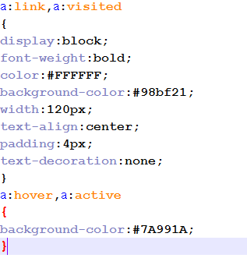


CSS Links
<!DOCTYPE html>
<html>
<head>
<link rel= "stylesheet " type="text/css" href="style.css">
</head>
<body>
<a href="http://nverner.am" target="_blank">This is a link</a>
</body>
</html>
style.css
a:link
a:hover

Slide 9
Task1:

Slide 10

Task2:

